Slide 1
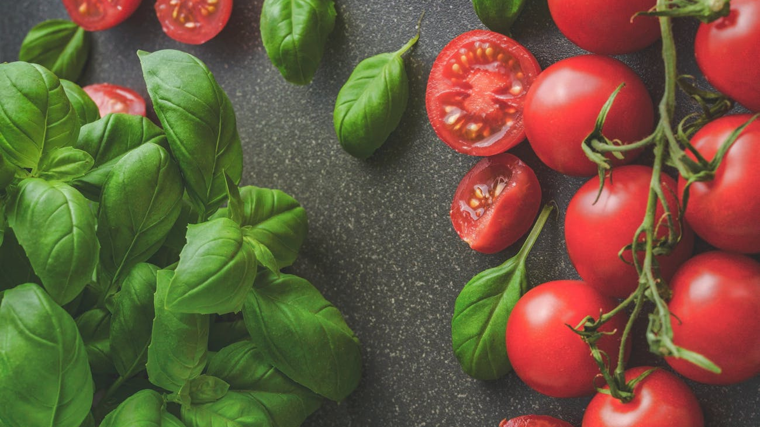
eatUP
Mani, Brad, Daniel, Shing & Marie

Slide 2
AGENDA
OVERALL CONCEPT OF OUR APPLICATION
MOTIVATION FOR DEVELOPING THIS APP
OUR DESIGN PROCESS
TECHNOLOGIES USED
DEMO OF APP’S FUNCTIONS
DIRECTION FOR FUTURE DEVELOPMENT

Slide 3
OVERALL CONCEPT OF OUR APPLICATION
eatUP is designed to help any user figure out what they want to eat depending if they’re on the go or if they’ve decided to stay at home and cook.

Slide 4
MOTIVATION FOR DEVELOPING THIS APP
Everyone has a busy life schedule that they’re trying to keep up with and we’ve all experienced the same thing with the question of “What should we eat?” and usually are stumped for answers.
So we wanted to make it easier for any user to pick their preferred meal or restaurant without having to spend a lot of time scrolling through google to figure it out.

Slide 5
OUR DESIGN PROCESS
Deciding whether you want a recipe or restaurant.
4 Options of the preferred choice
When the user decides on the desired choice, 3 new choices will show up keeping the first choice there.
Whatever the user decides as their final decision will show up after it has been clicked, this will either show the recipe steps or restaurant choices.
The user can decide whether they want to start over or go with their preferred choice.

Slide 6
TECHNOLOGIES USED
HTML
CSS
JAVA
JQuery
AJAX
Bootstrap
Google Fonts

Slide 7


API’S USED
We used the Food2Fork for recipes…
Zomato for Restaurants.

Slide 8
PROBLEMS WE FACED.
Restaurant API Zomato wasn’t working.
Time constraints.
Cost Restraints.
Front End/Back End code clashes.
Inexperience with Github – push and pull.

Slide 9
DIRECTION FOR FUTURE DEVELOPMENT
Making a restaurant locater.

Slide 10
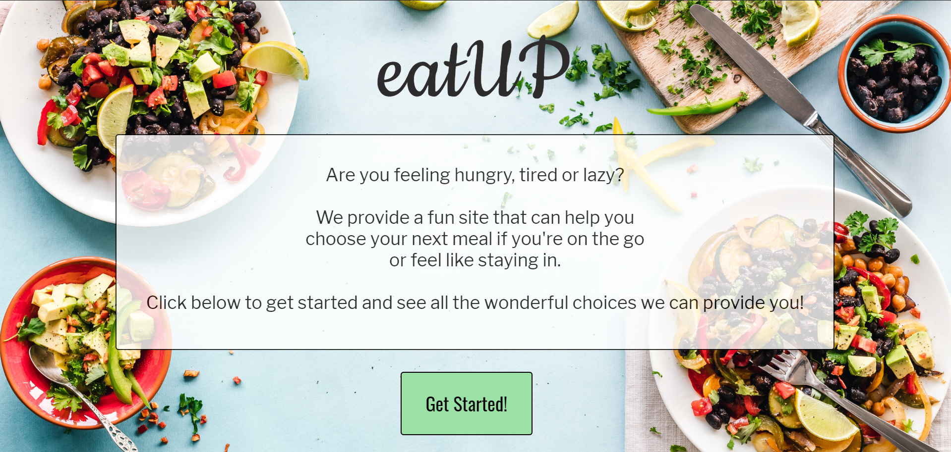
DEMO OF APP’S FUNCTIONS
https://daniel-brewer-stephenson.github.io/project1/

Slide 11
Any Questions?
Please ask after class, thx ☺

